Slide 1

Presentation on report
Project Name : BigBasket Product
Prepared by : Divya Sawant
Guid by : Vishal sir

Slide 2
Contant:
Introduction
Key findings
Conclusion
Recommendation

Slide 3
Introduction
The dataset consists of 27,555 rows and 9 col. from BigBasket dataset, an online grocery store. It includes detailed information on various products
Counts: Product:-23540, Category:-11, Sub-category:-90, Brand:-2313, Rating:-1to5 & Type:-426.
Product: The name or description of the produc
Category: The main category to which the product belongs (e.g., "Beauty & Hygiene," "Kitchen, Garden & Pets").
Sub category: More specific category within the main category. (e.g. Skin Care & Hair Care)
Brand: The brand name of the product.(e.g. bb royal & bb home )
Sale price: The price at which the product is sold.
Market price: The market price of the product.
Type: A classification of the product. (e.g. Hair oil & serup)
Rating: Customer rating of the product

Slide 4
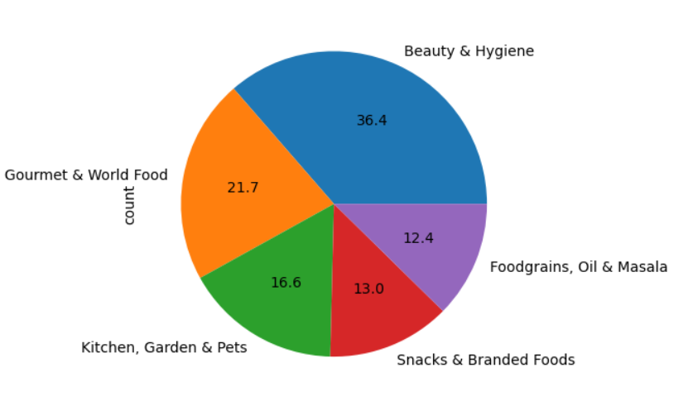
On the basis of category:
Top 5 category:
1. Beauty & Hygiene : 7867
2. Gourmet & World Food : 4690
3. Kitchen, Garden & Pets : 3580
4. Snacks & Branded Foods : 2814
5. Foodgrains, Oil & Masala : 2676

Slide 5
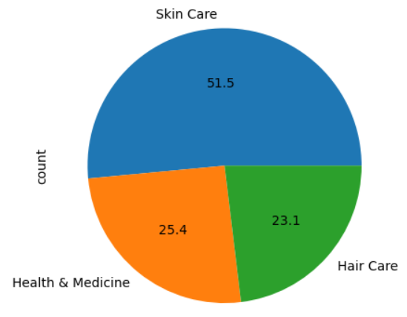
Sub-Category:
Top 3 Sub-category
Skin Care : 2294
Health & Medicine: 1133
Hair Care : 1028

Slide 6
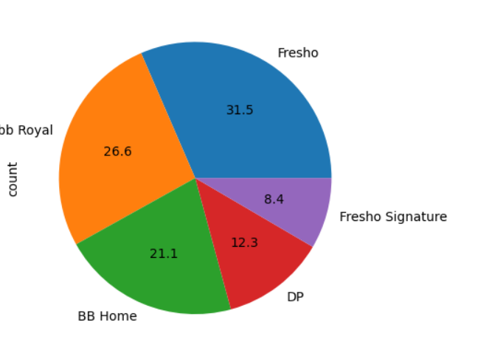
Brand:
Top 5 Brand
Fresho : 638
bb Royal : 539
BB Home : 428
DP : 250
Fresho Signature : 171

Slide 7
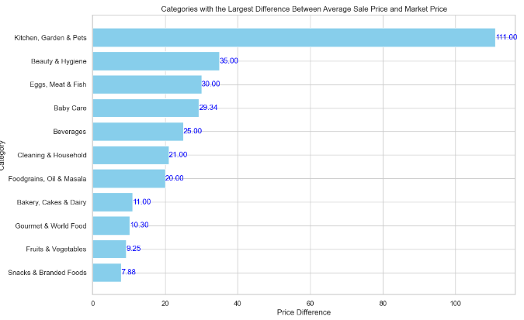
Difference b/w agv.sale price & market price
Key Insights:
• Largest Differences: Categories at the top have the largest differences between their average sale prices and market prices. For instance, "Kitchen, Garden & Pets" has the highest difference, meaning that on average, products in this category are sold at significantly lower prices compared to their market Prices.
• Smallest Differences: Categories at the bottom have smaller differences. For example, "Snacks & Branded Foods" shows the smallest price difference, indicating that the sale price is closer to the market price.

Slide 8
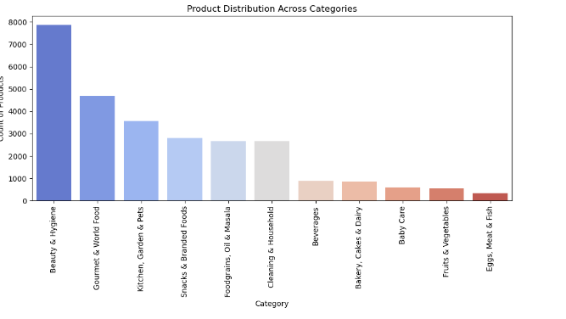
Product distribution across category
Key insights
Beauty & Hygiene has the largest variety of products, indicating a broad product range within this category.
Categories such as Gourmet & World Food and Kitchen, Garden & Pets also offer a wide variety of products, making them significant in terms of product diversity.
The lower product counts in categories like Eggs, Meat & Fish and Fruits & Vegetables suggest a more limited range of offerings in these areas compared to other

Slide 9
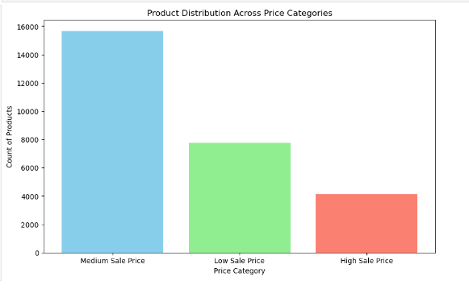
Product distribution across price category
Key insights
Medium Sale Price: The majority of products fall into this category, with around 15,671 products priced between 100 and 500 rupees.
Low Sale Price: This category includes approximately 7,753 products, which are priced below 100 rupees.
High Sale Price: There are about 4,131 products priced above 500 rupees

Slide 10
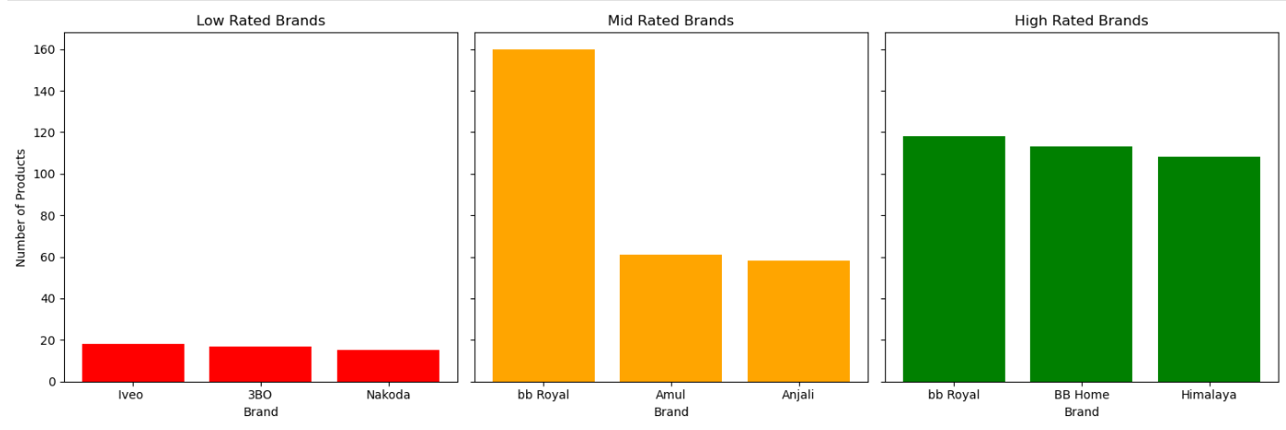
On the basis of rating
Key insights
❖ Low Rated Brands (red bars): Iveo: Approximately 20 products. 3BO: Approximately 20 products.
Nakoda: Approximately 20 products.
❖ Mid Rated Brands (orange bars):
bb Royal: Approximately 160 products.
Amul: Approximately 80 products.
Anjali: Approximately 80 products.
❖ High Rated Brands (green bars):
bb Royal: Approximately 120 products.
BB Home: Approximately 110 products.
Himalaya: Approximately 110 products

Slide 11
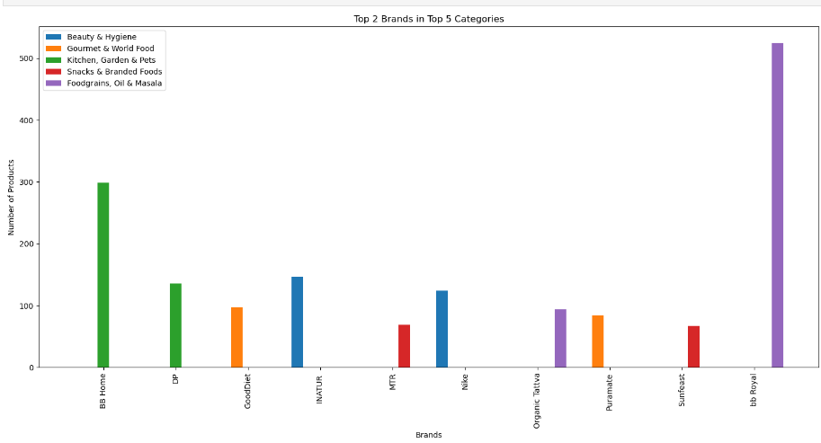
Top 2 brand in top category
Key insights
1) Foodgrains, Oil & Masala:
bb Royal is the leading brand with the highest number of products. (~500).
Organic Tattva follows as the second brand within this category.
2)Kitchen, Garden & Pets:
BB Home has the most products (~350).
DP is the second brand in this category with fewer products(~150).
3)Beauty & Hygiene:
INATUR and Nike are the top brands, with INATUR leading (~150) and Nike following closely.
4)Snacks & Branded Foods:
MTR and Sunfeast are the top brands, with MTR leading but significantly fewer products compared to other categories
5)Gourmet & World Food:
GoodDiet and Purrnate are the top brands, with GoodDiet leading (~100) and Purrnate having fewer products.

Slide 12

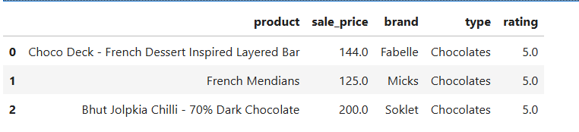
Recommendation System:

Slide 13
Conclusion:
The dataset reveals a clear distribution of product prices across different categories. The majority of products fall within the medium price range (100-500 rupees), followed by a significant number of low-priced products (below 100 rupees), and a smaller proportion of high priced products (above 500 rupees). This indicates that the product assortment heavily leans towards affordable and mid-range products.

Slide 14
Recommendations:
Focus on Medium-Priced Products: Given that the majority of products are in the medium price range, efforts should be concentrated on optimizing the availability and marketing of these products to meet consumer demand.
Expand Low-Priced Product Range: With a substantial number of products in the low price range, consider expanding this category to attract budget-conscious consumers and enhance market share.
Promote High-Priced Products: Develop targeted marketing strategies to promote high priced products. This could include highlighting premium features, quality, and exclusive benefits to attract higher-income segments.

